Slide 1
Multiprocessor Task Executor using WORK Queues
By:
Jagan savanth reddy
Shyamsunder

Slide 2
INTRODUCTION
Server applications are oriented around processing a large number of short tasks that arrive from some remote source
Example: Web servers, database servers, file servers, or mail servers.
The processing of each individual task is short-lived and the number of requests is large regardless of how the request arrives

Slide 3
APPROACHES
Thread-per-Request:
One of the simplistic model for building a server application would be to create a new thread each time a request arrives and service the request in the new thread.

Slide 4
Disadvantage
The overhead of creating a new thread for each request is significant.
Server that created a new thread for each request would spend more time and consume more system resources creating and destroying threads than it would processing actual user requests.
Creating too many threads in one JVM can cause the system to run out of memory or thrash due to excessive memory consumption.

Slide 5
APPROACHES
Single Background Thread:
Another common threading model is to have a single background thread and task queue for tasks of a certain type.
Because there is only one thread, it is undesirable to execute tasks in that thread that may take a perceptible amount of time to complete.

Slide 6
DISADVANTAGES
Both the thread-per-task and the single-background-thread approaches can work perfectly well in certain situations but there are certain limitations:
The thread-per-task approach works quite well with a small number of long-running tasks but what if there are a large number of tasks?
The single-background-thread approach works quite well so long as scheduling predictability is not important, but what if the priority for tasks increases?

Slide 7
However, most server applications are oriented around processing large numbers of short-lived tasks or subtasks.
It is desirable to have a mechanism for efficiently processing these tasks with low overhead, as well as some measure of resource management and timing predictability.

Slide 8
THREAD POOL
By reusing threads for multiple tasks, the thread-creation overhead is spread over many tasks.
As a bonus, because the thread already exists when a request arrives, the delay introduced by thread creation is eliminated.
Thus, the request can be serviced immediately, rendering the application more responsive.

Slide 9
THREAD POOL
Furthermore, by properly tuning the number of threads in the thread pool, you can prevent resource thrashing by forcing any requests in excess of a certain threshold to wait until a thread is available to process it.

Slide 10
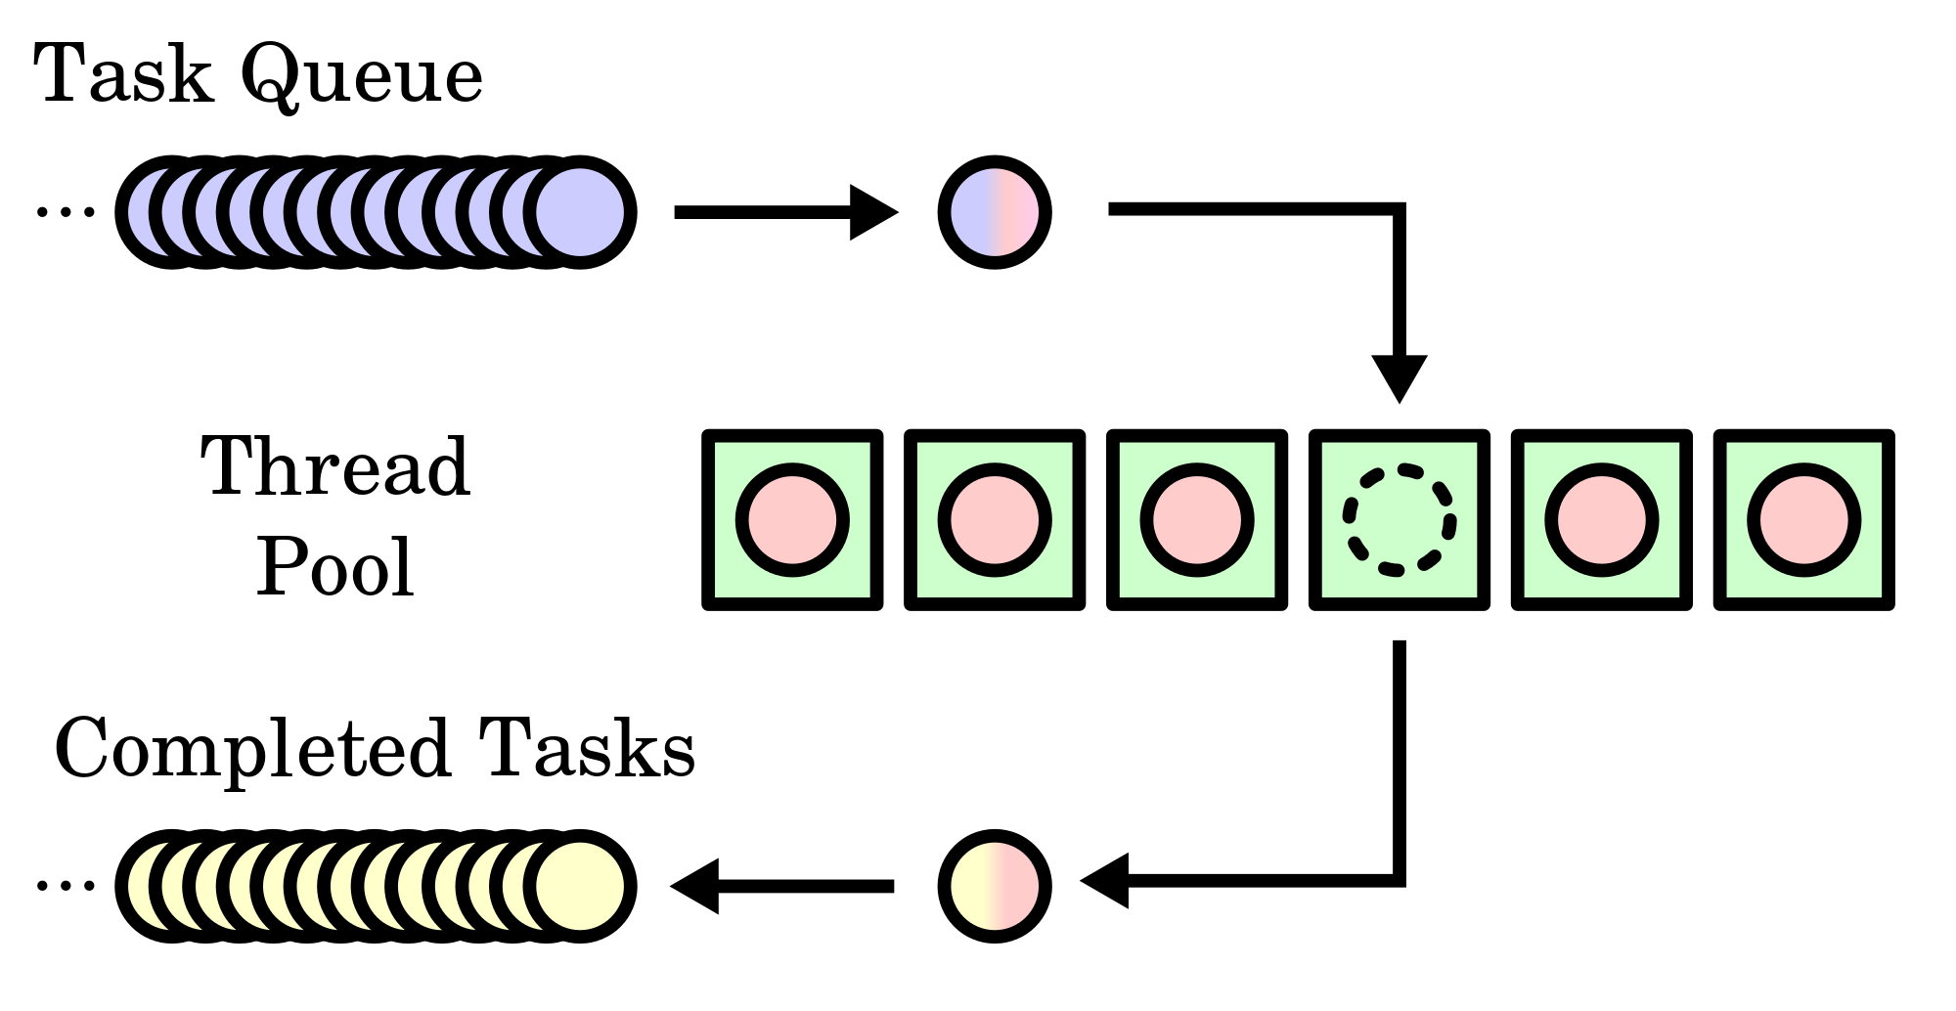
THREAD POOL

Slide 11
WORK QUEUES
Work Queue is a framework for building large master-worker applications.
Work Queue applications are written in common programming languages using a simple API that allows users to define tasks, submit them to the queue, and wait for completion.

Slide 12
WORK QUEUES IMPLEMENTATION
We need a work queue combined with a fixed group of worker threads, which uses wait() and notify() to signal waiting threads that new work has arrived.
The work queue is generally implemented as some sort of linked list with an associated monitor object. In this case FIFO queues.

Slide 13
IMPLEMENTATION METHOD
TASK EXECUTOR:
The Task Executor is a service that accepts instances of Tasks and executes each task in one of the multiple threads maintained by the service.
The service maintains a pool of pre-spawned threads that are used to execute Tasks.

Slide 14
TASK EXECUTOR

Slide 15
TASK EXECUTOR
Clients add the tasks to the FIFO queue. The application-specific Task executes for some amount of time before completing by returning method
When the FIFO queue is empty the thread’s execution is blocked until a new task is added to the queue.
If a FIFO queue is full the client’s thread’s execution is blocked until a task is been removed from the queue.

Slide 16
Handling Risks of Using Thread Pools
While the thread pool is a powerful mechanism for structuring multithreaded applications, it has some significant risks.
Deadlock
Resource thrashing
Concurrency errors
Thread leakage
Request overload

Slide 17
Tuning the pool size
The optimum size of a thread pool depends on the number of processors available and the nature of the tasks on the work queue.
On an N-processor system for a work, you will generally achieve maximum CPU utilization with a thread pool of N or N+1 threads.

Slide 18
CONCLUSION
The thread pool is a useful tool for organizing server applications.
Several issues are to be handled when implementing and using one, such as deadlock, resource thrashing, and the complexities of wait() and notify().
Executor classes from util.concurrent such as PooledExecutor which are concurrency utilities and open sources. They can be used to implement Thread pool

Slide 19
Future work
We would like to investigate on the methods to improve the speed of concurrent execution of tasks. Although there are many algorithms which works the best on the parallel task execution, implementing the one which is least prone to deadlocks and recourse thrashing is challenging. So developing an architecture from the scratch which utilizes parallel core CPU utilization and which deals with all the above mentioned problems should be the future task.

Slide 20
References:
[1] A Task Tree Executor: New Runtime for Parallelized Legacy Software By Miroslav Popovic1, Ilija Basicevic1, and Vladislav Vrtunski2 1 University of Novi Sad, Department for Computing Automation, 2 DMS Grupa, Ltd, email: vrtunski@neobee.net [2] A Task Tree Executor Architecture Based on Intel Threading Building Blocks Miroslav Popovic, Miodrag Djukic, Vladimir Marinkovic [3] Algorithm for scheduling of Tasks on Moving Executors with uncertain processing times Institute of Control and Systems Engineering, St. 11/17, 50-370 Wroclaw, Poland [4] M. Popovic, I. Basicevic, and V. Vrtunski, A Task Tree Executor: New Runtime for Parallelized Legacy Software, 16th IEEE International Conference [5] https://en.wikipedia.org/wiki/Threadpool [6] https://msdn.microsoft.com/en-us/library/windows/desktop/ms686760 (v=vs.85).aspx [7] http://www.ibm.com/developerworks/library/j-jtp0730/ [8] http://docs.oracle.com/javase/7/docs/api/java/util/concurrent/Executor.html

Slide 21
THANK YOU!!!

